Slide 1
Ultrasonic sensor HC-SR04
UgochuKWU ELEONU

Slide 2
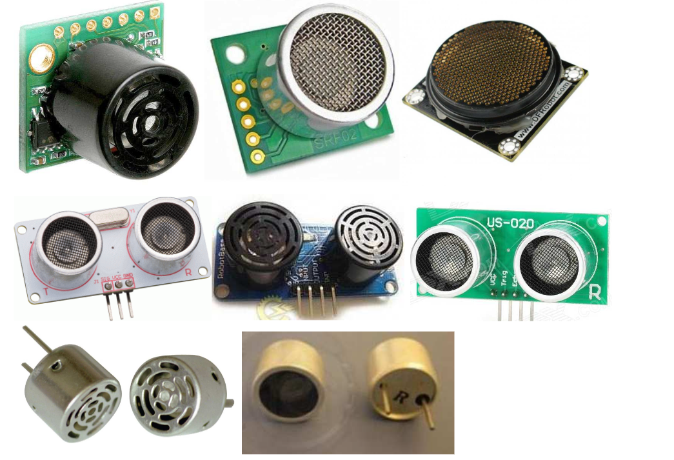
Content
Introduction
Procedure
Result
Analysis

Slide 3
INTRODUCTION
The Ultrasonic sensor is a sensor that uses ultrasounds to measure time of travel which can then be used to measure distance travelled

Slide 4
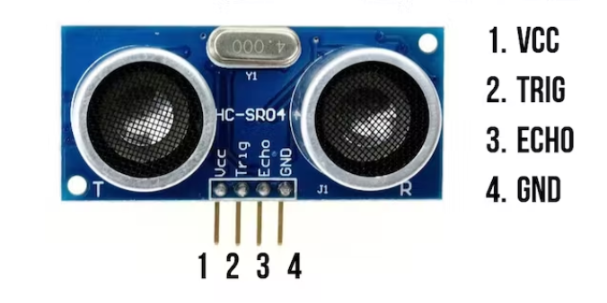
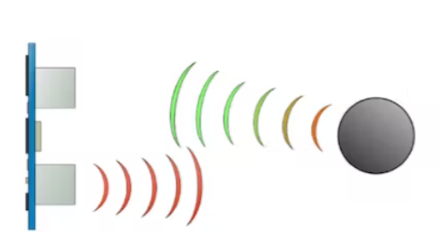
The Ultrasonic sensor is equipped with a receiver that sends out ultrasounds which is reflected by the target and is collected by the receiver
The Sensor measures the time taken for the sound wave to be propagated to and back at it. The time travelled is then compared to the speed of sound and used to calculate the distance between the sensor and the target

Slide 5
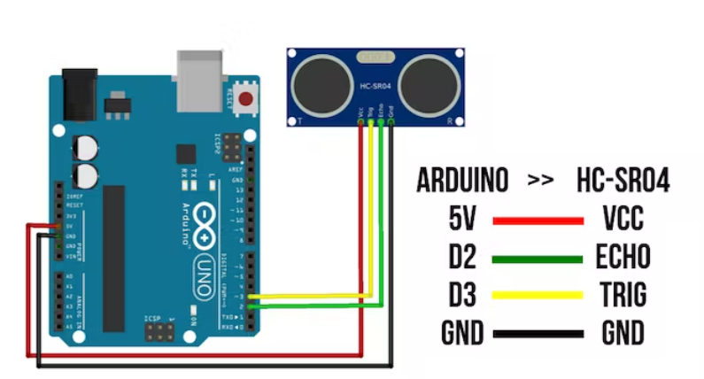

Slide 6
Table
Actual | Avg Measure
0 | 2
1 | 2
2 | 2
3 | 2.6
4 | 3.8
5 | 5
6 | 6
7 | 6.8
8 | 8
9 | 9
10 | 10.4
Actual | Avg Measure
20 | 19.9
30 | 30
40 | 40
50 | 49.9
60 | 59.9
70 | 70
80 | 79.8
90 | 90
100 | 100
150 | 147
200 | 199
Actual | Avg Measure
250 | 250
300 | 299
350 | 358
400 | 398
450 | 446
500 | 8042
600 | 8042
700 | 8042
800 | 8042
900 | 8042
1000 | 8042

Slide 7
Chart

Slide 10
Result
Error
Effective angle
Range
2cm to 400cm
Sensor struggled to maintain range, but this was the best result to go with
Sensor averaged a 3.92% error
During application, it is advisable to use an error value of about 5%
Sensor was extremely sensitive to changes in angles over 10 degrees
Effective angle is between 0 to 10 degrees
Notes:
(These don’t have designer IDs since they were based off the default master slides already in the deck.

Slide 11
Result
Repeatability
Resolution
Sensitivity
Repeatability was difficult to achieve, the sensor required an almost isolated environment to function
Repeatability was about 90% during perfect conditions
Sensor did not easily detect output changes < 1cm.
Resolution was seen to be around 0.6cm
Sensitivity as seen in the slope of the plotted graph was measured to be 0.8964

Slide 12
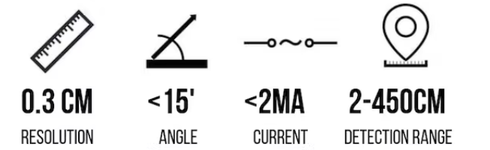
ANALYSIS

Slide 13
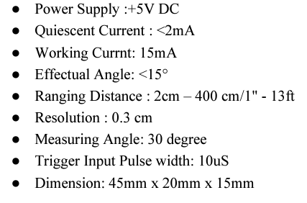
ACTUAL
Measured
Range: 2cm – 400cm
Effective angle: 0 – 10
Error: 3.92%
Resolution: 0.6cm
Sensitivity: 0.8964

Slide 14
Summary
The Sensor properties was studied, and the following can be deduced
Sensor is prone to noise and interference and would only work properly in isolated environments
The Manufacturer specifications are close to the measured specifications but only during ideal conditions
For application purposes a special device to help isolate the sound waves for proper propagation is advisable

